Slide 1
vSphereDSC Reverse
Automate DSC Configuration Files

Slide 2
Agenda
Purpose
Flow
Components
Sample Run
Further Use Cases

Slide 3
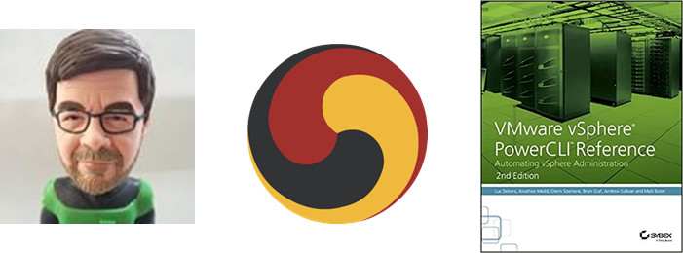
Bio
Luc Dekens
Belgium (the Flemish part)
Virtualisation ➔ PowerShell/PowerCLI ➔ SDDC ➔ DSC
PowerCLI Reference 1 ed & 2 ed
VMTN Community LucD
Blog LucD.info
Twitter @LucD22

Slide 4
Purpose
vSphereDSC Resource module allows vSphere configuration through Configuration files
How can we get Configuration files for an existing vSphere environment?
Painstakingly write it out
Automate that process
Why would we need such Configuration files?
SDDC
Diffs
Audit
….

Slide 5
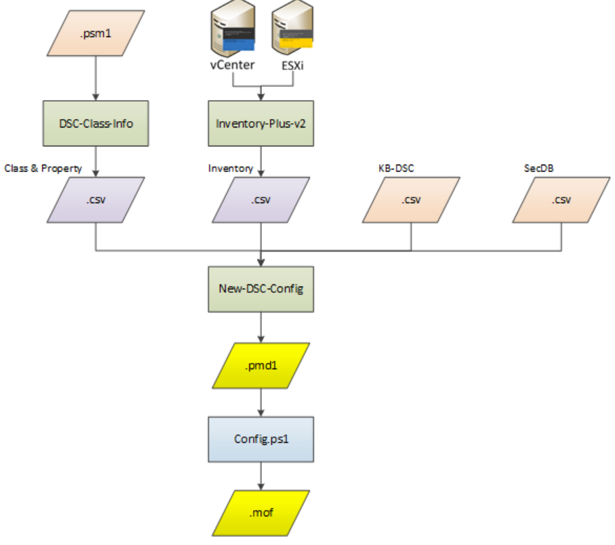
Flow

Slide 6
Get-DSCClassInfo 1
DSC-Class.Info.ps1
Extracting Class information
Input .psm1 file
Use Abstract Syntax Tree (AST)

Slide 7
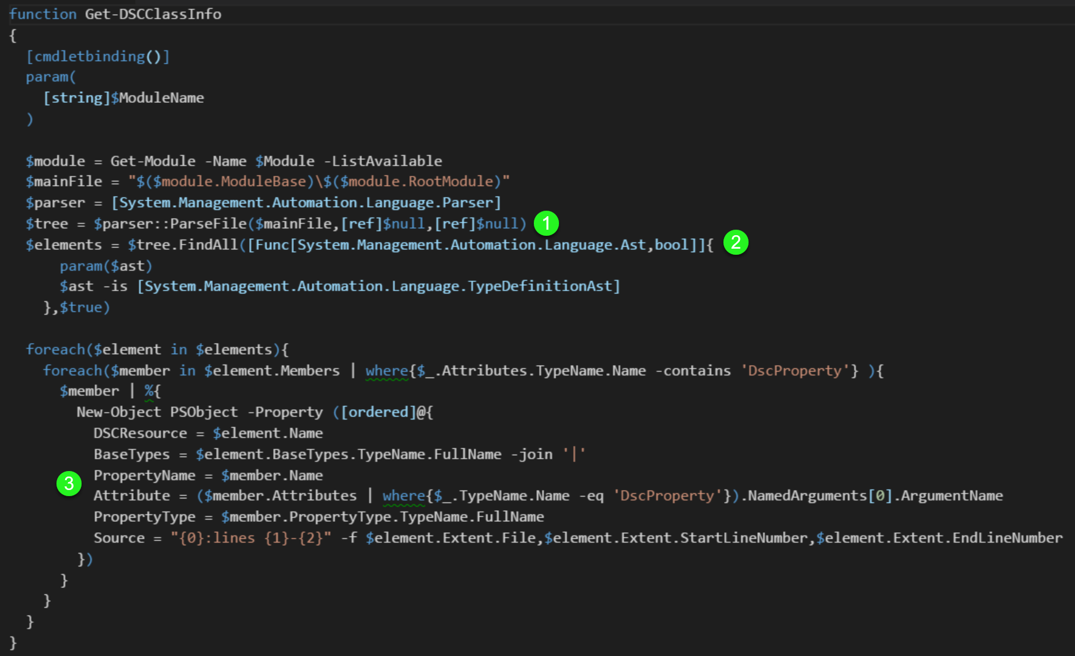
Get-DSCClassInfo 2

Slide 8
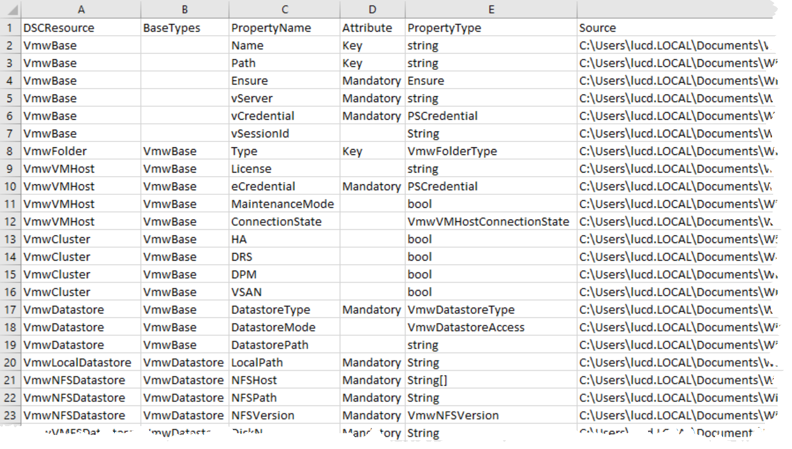
Get-DSCClassInfo 3

Slide 9
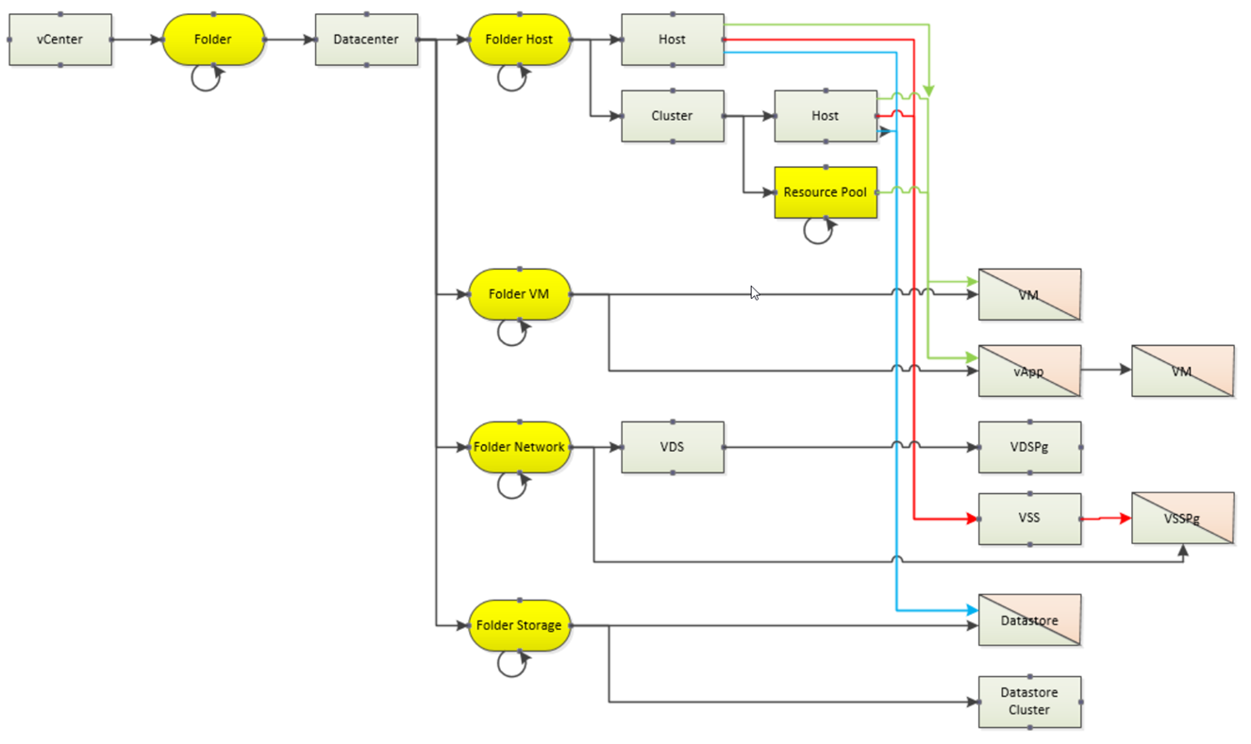
Get-InventoryPlus 1
The Get-Inventory cmdlet does not return all object we want
There is a requirement to see “all” paths for objects

Slide 10
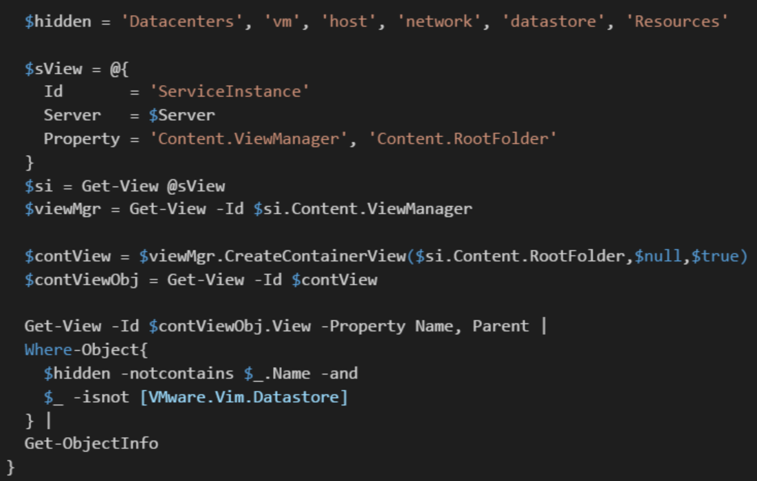
Get-InventoryPlus 2

Slide 11
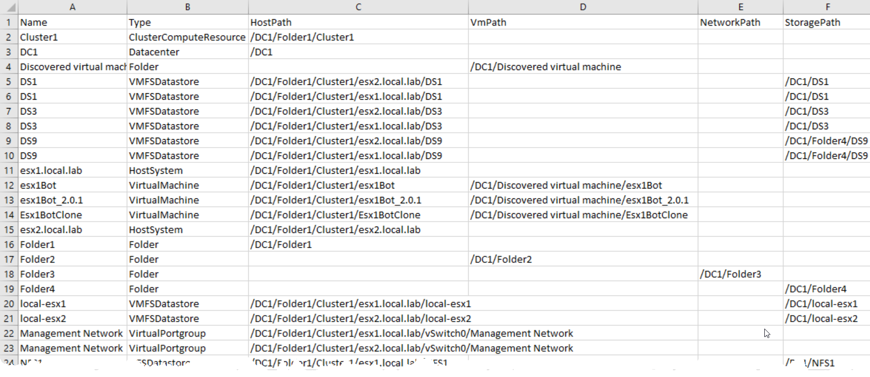
Get-InventoryPlus 3

Slide 12
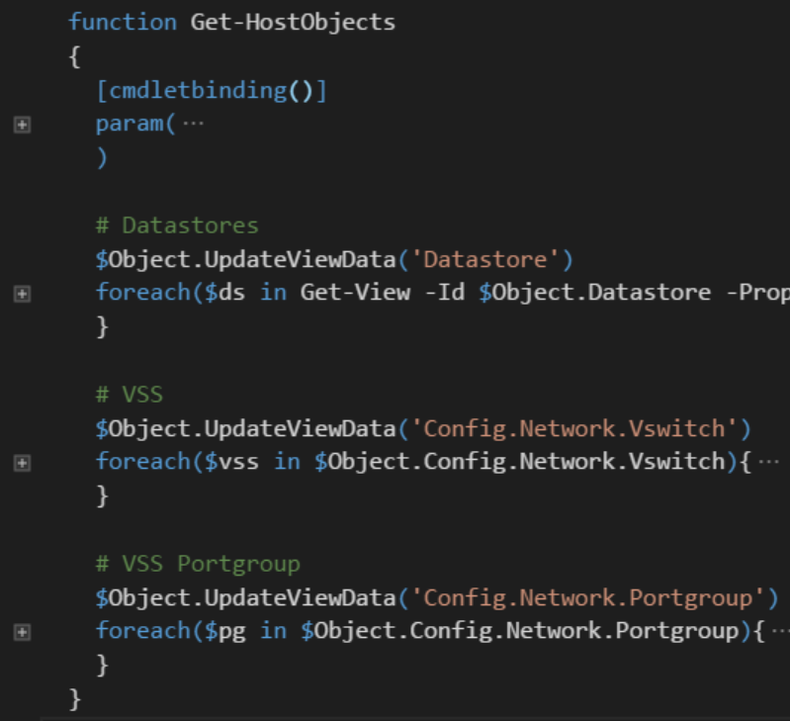
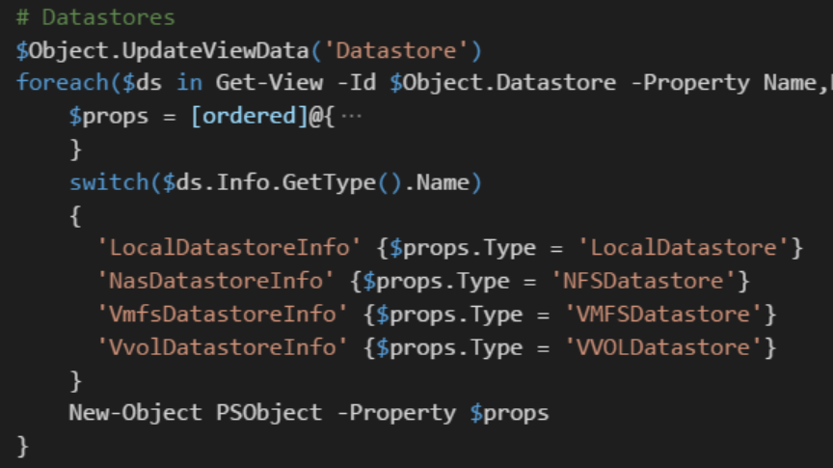
Get-InventoryPlus 4
Some objects only visible through ESXi node!

Slide 13
KB-DSC 1
Configuration data needs the values for the “where” data
This DB contains the formula on how get the value for a class/property

Slide 14
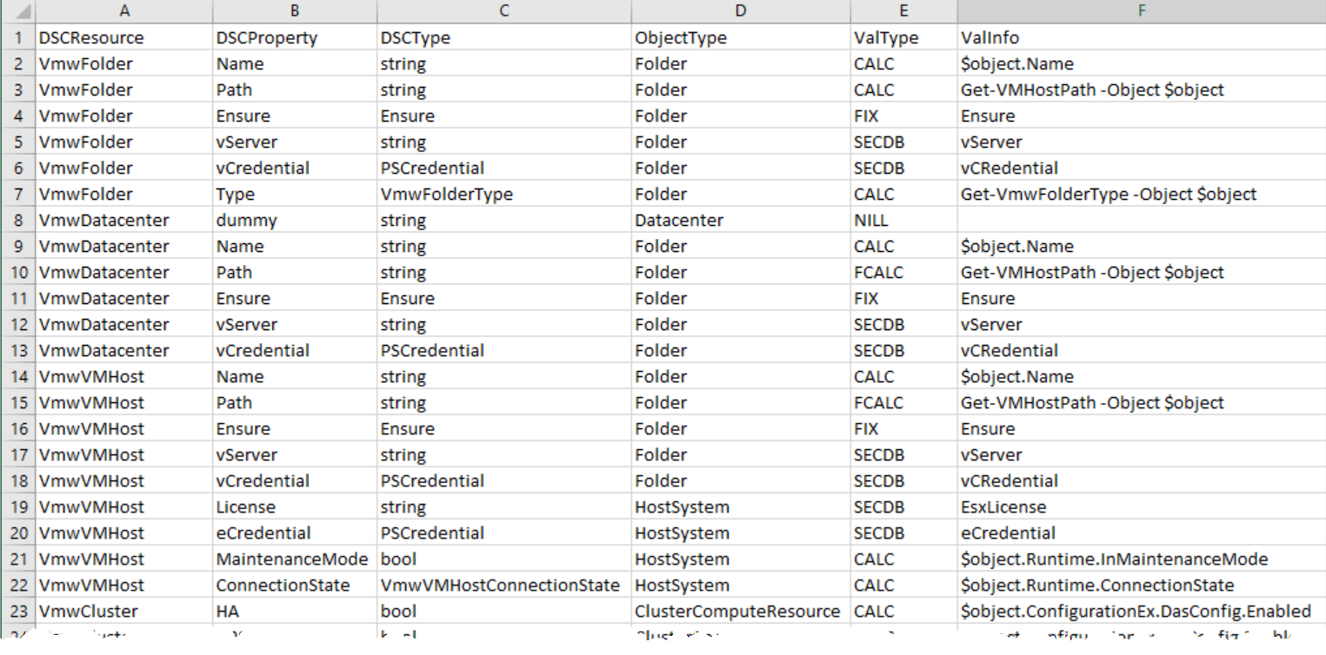
KB-DSC 2

Slide 15
KB-DSC 3
The ValType and ValInfo fields indicate how a value can be retrieved
Currently there are following options
FIX: a constant value
CALC: property, the current object is in $object
FCALC: function to calculate the value
SECDB: values that shall be stored secure (under work!)
NIL: entry not needed in ConfigurationData

Slide 16
Sec-DB
Credentials can not be extracted
Sensitive information (e.g. License keys) in an encrypted DB
Still looking for the better solution

Slide 17
New-DSC-Config 1
Combines information from the 4 data files
Creates the Configuration data file (.psmd1)
DSC properties are retrieved/calculated via DSCKB entries

Slide 18
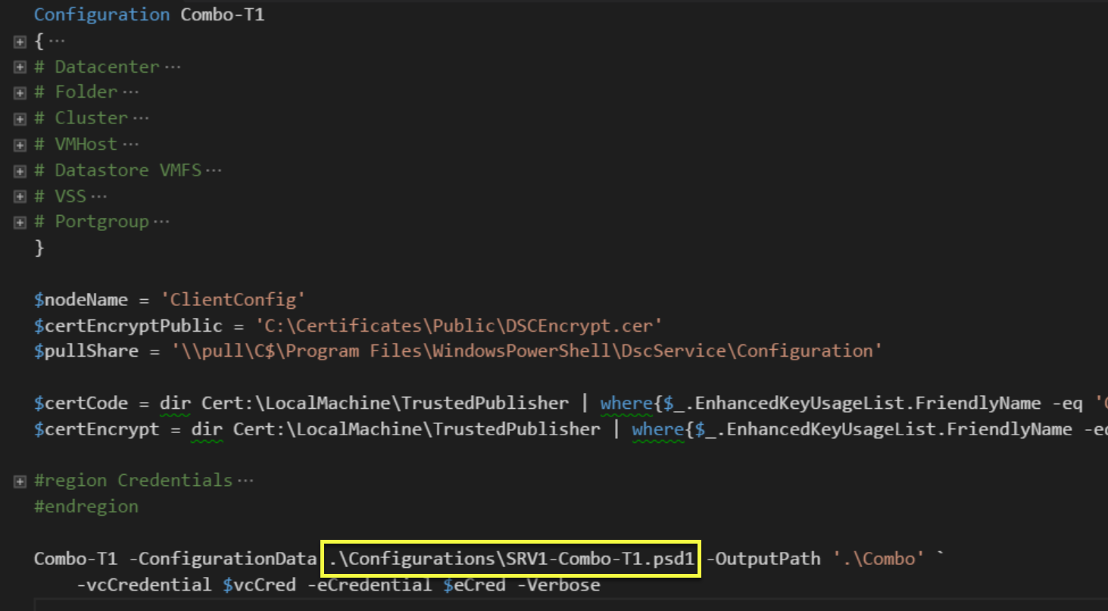
New-DSC-Config 2

Slide 19
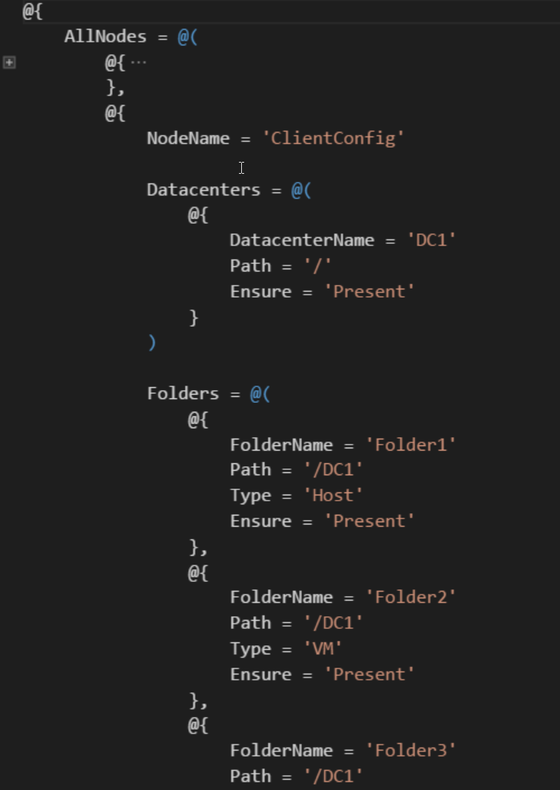
New-DSC-Config 3

Slide 20
Use Cases
Current environment to SDDC
Version control
Diffs
Replicate the environment
DRM (see also SDDC)
Lab/GreenField
Migration: full or partial migration of environment
New platform
Upgrade

Slide 21
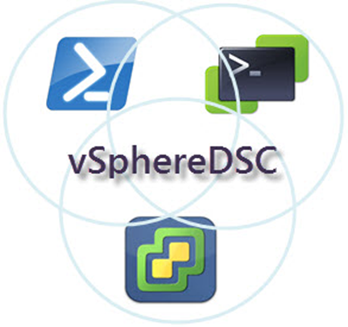
Q&A

